Slide 1
Music was my first love
Project by Dairah castricum 3va

Slide 2

Preface
Introduction pop music
History of pop
3 pop songs

Slide 3

Introduction of pop music
Collective name.
How do you recognise the genre pop?
Combinations with pop music.

Slide 4
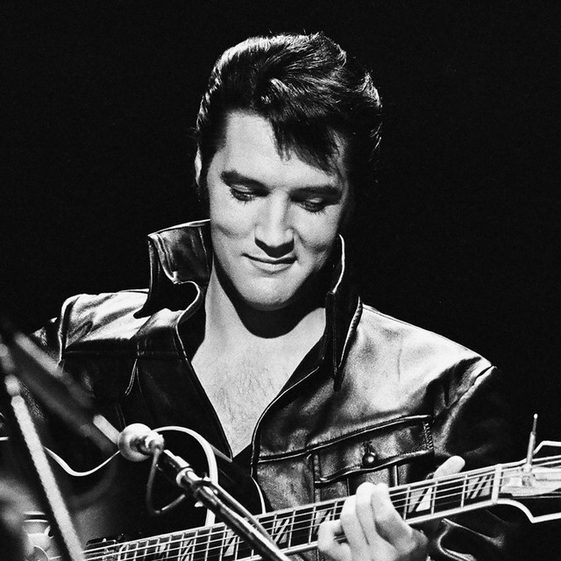
History of pop + artists
How did pop originate?
Elvis presley
King and queen of pop.

Slide 5

3 songs from the 80s
Beat it – Michael Jackson – 1982
The winner takes it all – ABBA – 1980
I wanna dance with somebody – Whitney Houston – 1987

Slide 6
The end
Sources: English Wikipedia – wikikids – study.com
Thank you for paying attention ;)

